Slide 1
Digital Buffalo Concussion Treadmill Test
CS 4605/7470 Final Presentation
Sami Belhareth
Joshua Kent
Karan Singh

Slide 2
Overview
Background
Related Work
Technical Details and Progress
Future Work

Slide 3
Background
The Buffalo Concussion Treadmill Test (BCTT) is a metric used by trained professionals (physical therapists, certified trainers, etc.) to help patients recovering from concussions and usually those suffering from post-concussive symptoms (PCS).
This project will digitalize the traditional test into a mobile iOS application and web application such that it can be conducted more efficiently. Furthermore, the digital setup will permit the use of the data for health informatics and clinical decision support in future work.

Slide 4
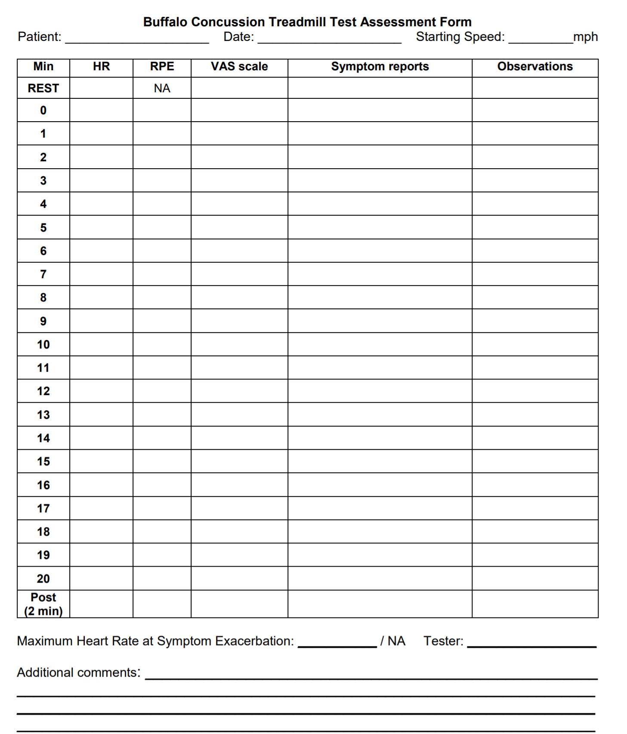
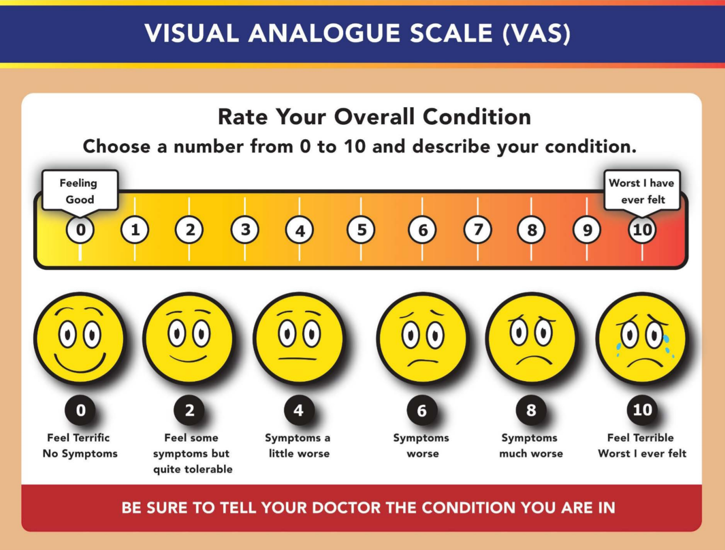
Background
Paper version of the test
Uses Visual Analog Scale (VAS)

Slide 5
Related Work
No significant related work:
While there has not been substantial literature pertaining to the digitization of the BCTT, there has been work in proving the efficacy and validity of the BCTT, particularly literature detailing the relationship between BCTT performance over time and concussion recovery [1].
Using Google Scholar, we searched for the following pairs of boolean search terms: “Buffalo concussion treadmill test” AND “digital”; “Buffalo concussion treadmill test” AND “FHIR” (acronym for fast healthcare interoperability resources, a standard in the electronic medical record field).
There were no relevant search results that included these terms of interest, indicating that there is little or no work pertaining to implementing the Buffalo concussion treadmill test in a digital format.

Slide 6
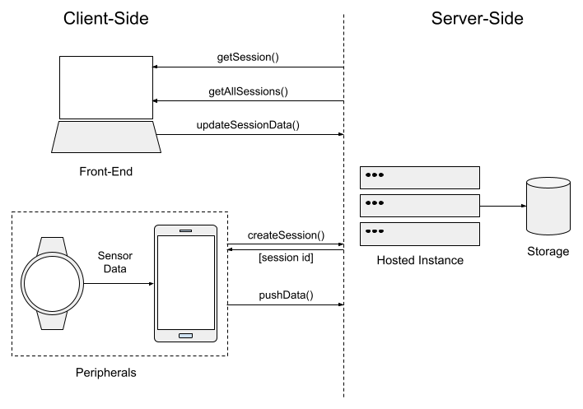
End-Point Interaction

Slide 7
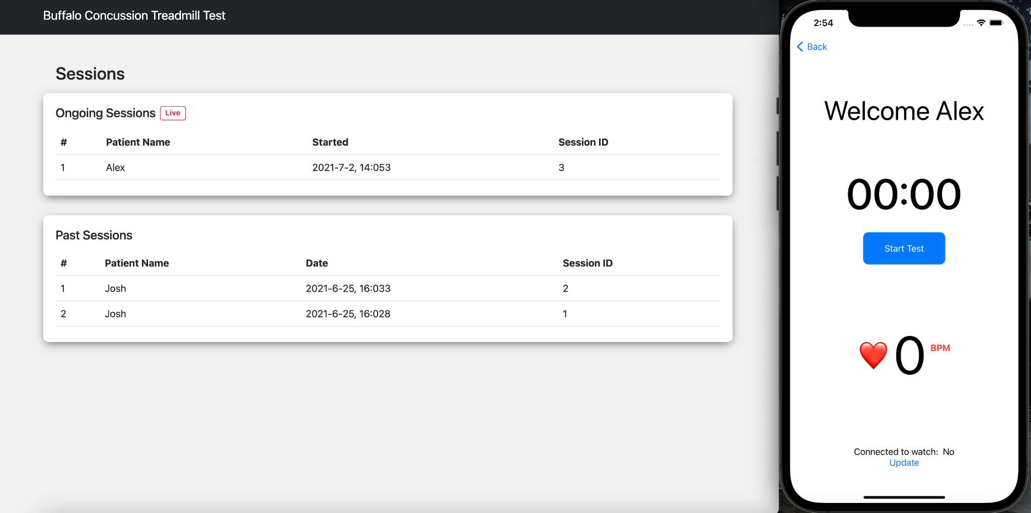
Web Application Interface

Slide 8
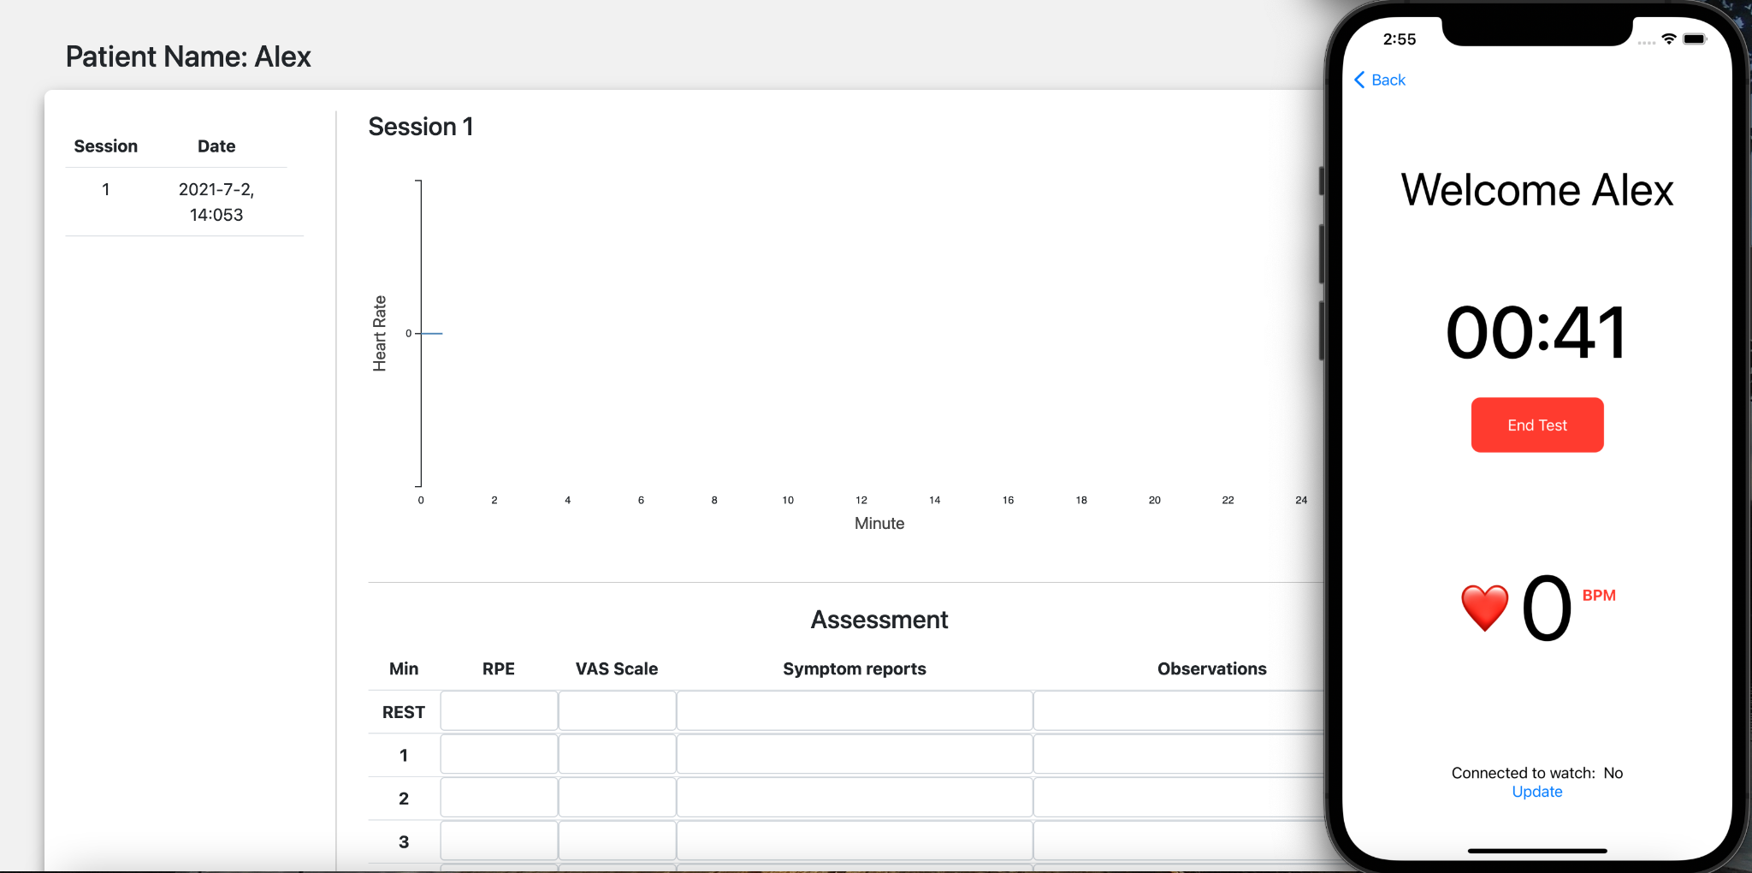
Web Application Interface

Slide 9
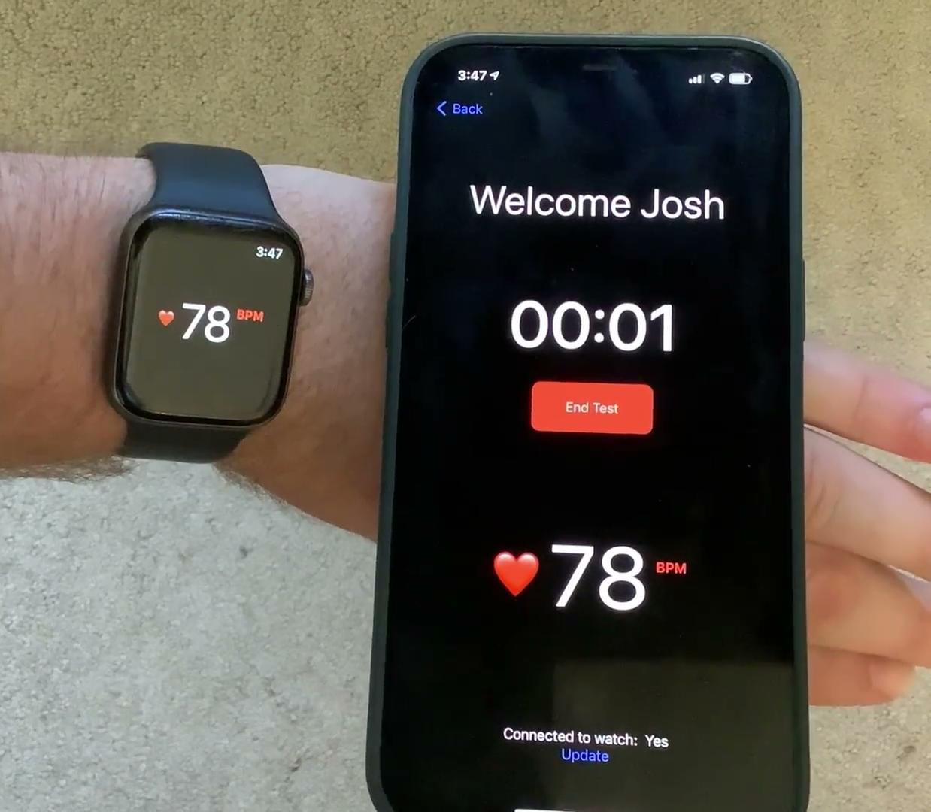
Watch & iPhone Demo

Slide 10
Technical Details: IOS & Web Application
Live Demo

Slide 11
Future Work
Web app:
Electronic health record (EHR) workflow & system
Built-in analytics and recommendations
iOS app:
Beautification: more aesthetic color scheme, font choice, layout, etc.
Robust prompting for:
Rating of Perceived Exertion (RPE)
Visual Analogue Scale (VAS)
Symptoms
Inclusion of instructions and stopping criteria in app
Overall
Full user and usability testing process

Slide 12
Thank you!
Questions?

